Slide 1

Fraud Detection in Financial Transactions
Presented by-
Ahmed Hossam

Slide 2
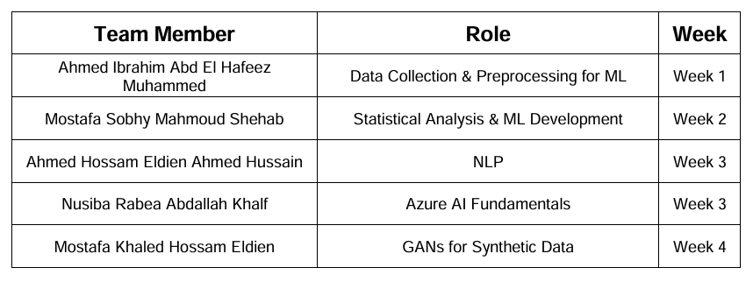
Team Member Project

Slide 3
Credit Card Fraud Overview
Credit card fraud involves unauthorized use of credit cards to obtain goods, services, or funds. It affects both individuals and businesses, leading to financial losses and compromised personal information. Some common types of credit card fraud are:
Account Takeover Fraud:
Fraudsters gain access to a victim’s account to make unauthorized transactions. In 2023, account takeover attacks increased by 354% year-over-year, resulting in almost billion in losses

Slide 4
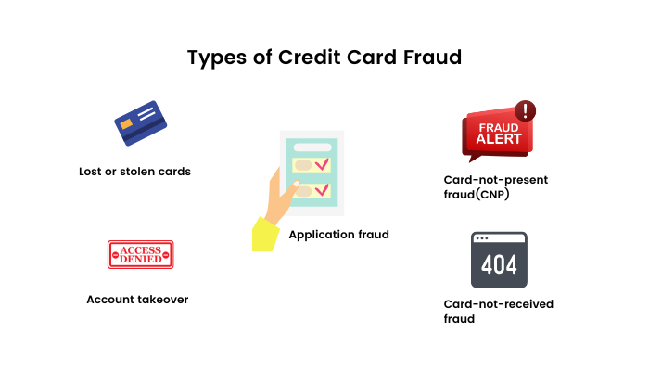
Card Skimming:
Fraudsters use devices to capture card information from ATMs or point-of-sale terminals. Card skimming costs consumers and financial institutions.
Phishing Scams:
Trick victims into providing card information through fake emails, texts, or websites

Slide 5
Week 1- Data Collection and Preprocessing
Tasks: Data Collection: Obtain financial transaction data ,including labeled fraudulent and non-fraudulent transactions.
Data Preprocessing: Clean and preprocess the data, addressing missing values and normalizing features.
Tools: Python (Pandas, NumPy).

Slide 6
Week 2- Statistical Analysis and Machine learning
Tasks:
Correlation Analysis: A heatmap displayed correlations among features, revealing strong relationships that could influence the target variable.
Machine Learning Modeling: Develop and evaluate classification models for fraud detection (e.g., Logistic Regression, Random Forest). o Tools: Python (Scikit-learn, Stats models).

Slide 7
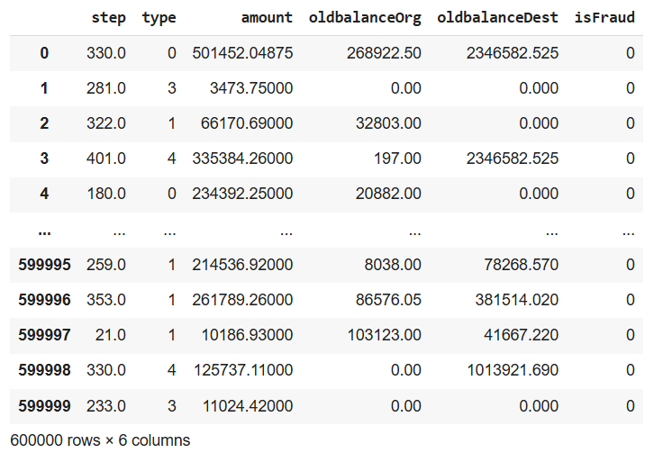

Slide 8
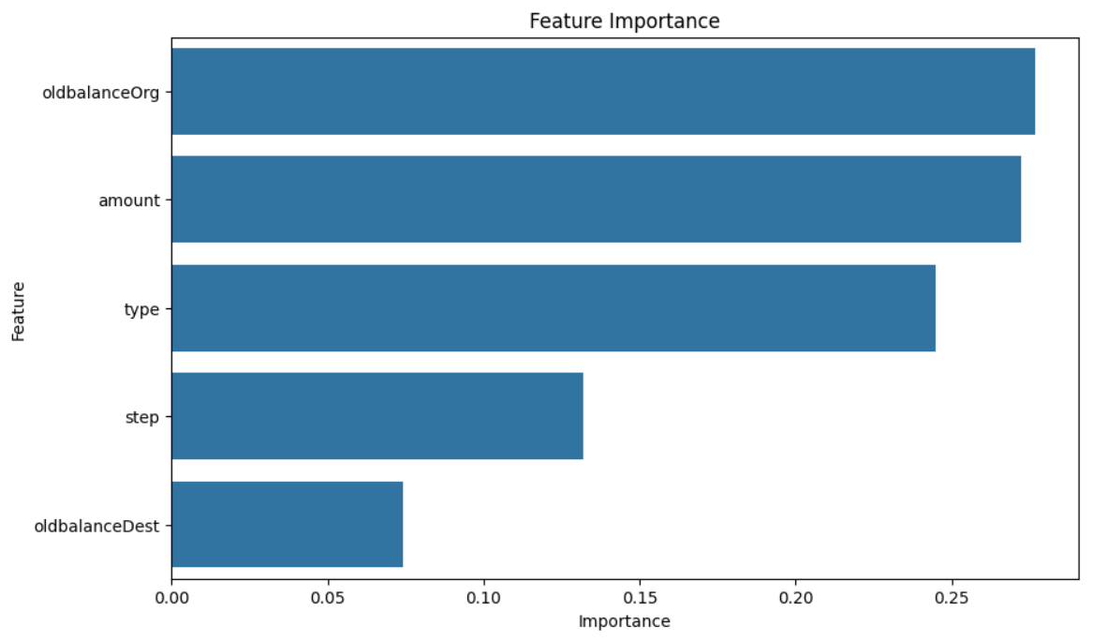

Slide 9
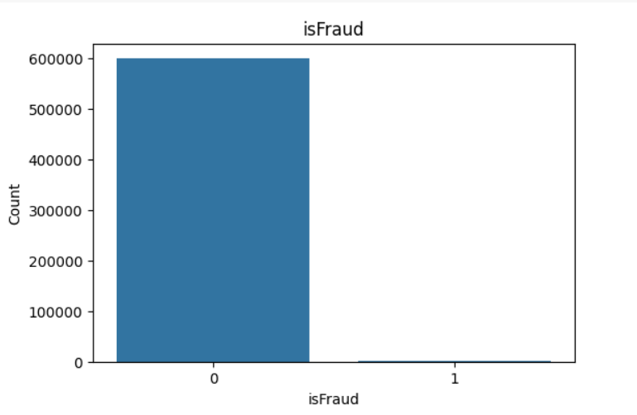

Slide 10
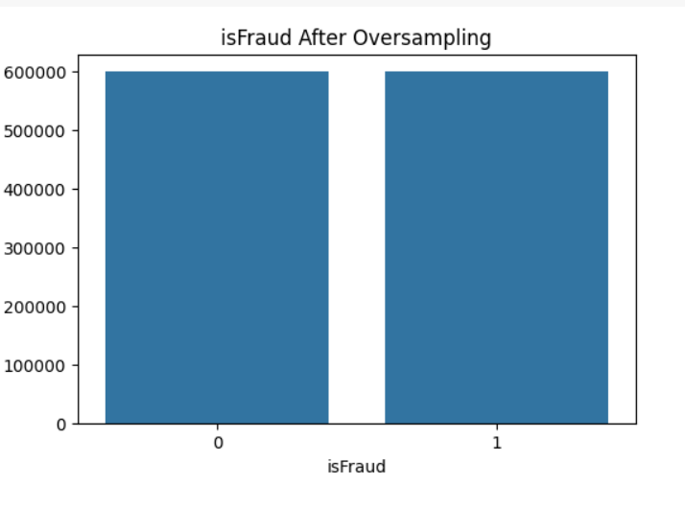

Slide 11
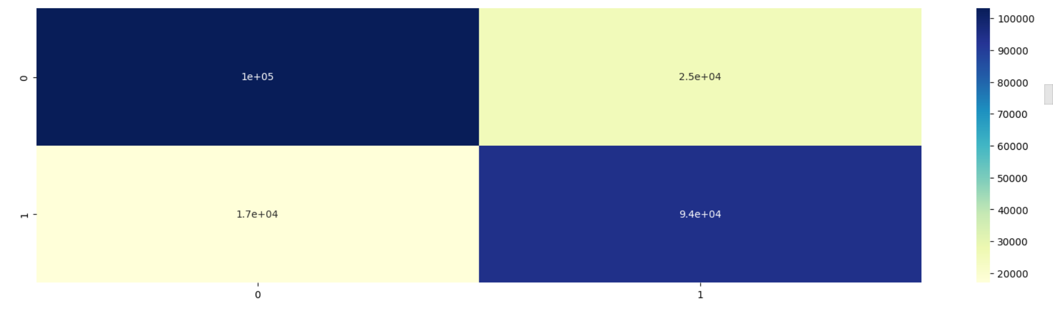

Slide 12
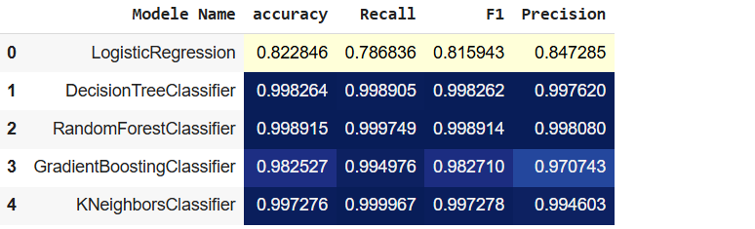

Slide 13
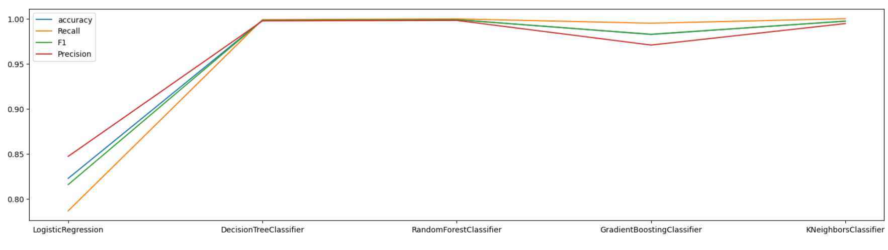

Slide 14
Week 3: Advanced Techniques and Azure Integration
Tasks:
NLP for Transaction Notes: Apply NLP techniques to analyze transaction descriptions or notes.
2. Azure AI Fundamentals: Deploy the fraud detection model using Azure Machine Learning or Azure Synapse. o Tools: Azure Machine Learning, Python (NLTK, SpaCy ).

Slide 15
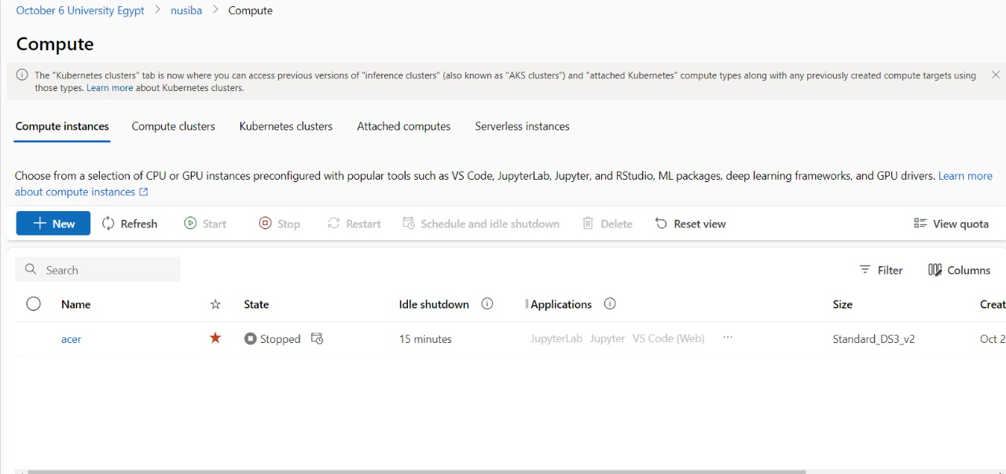

Slide 16
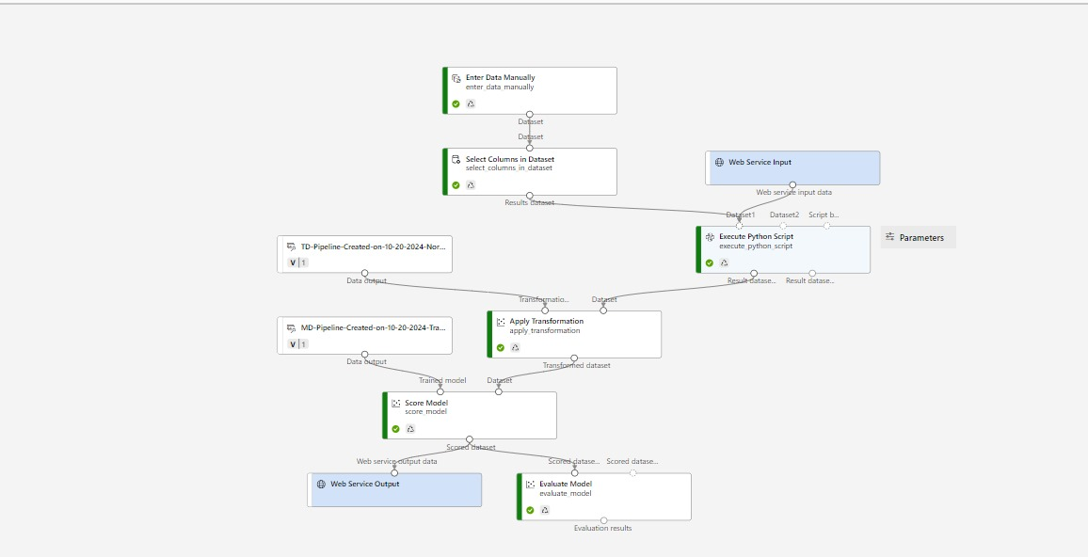

Slide 17
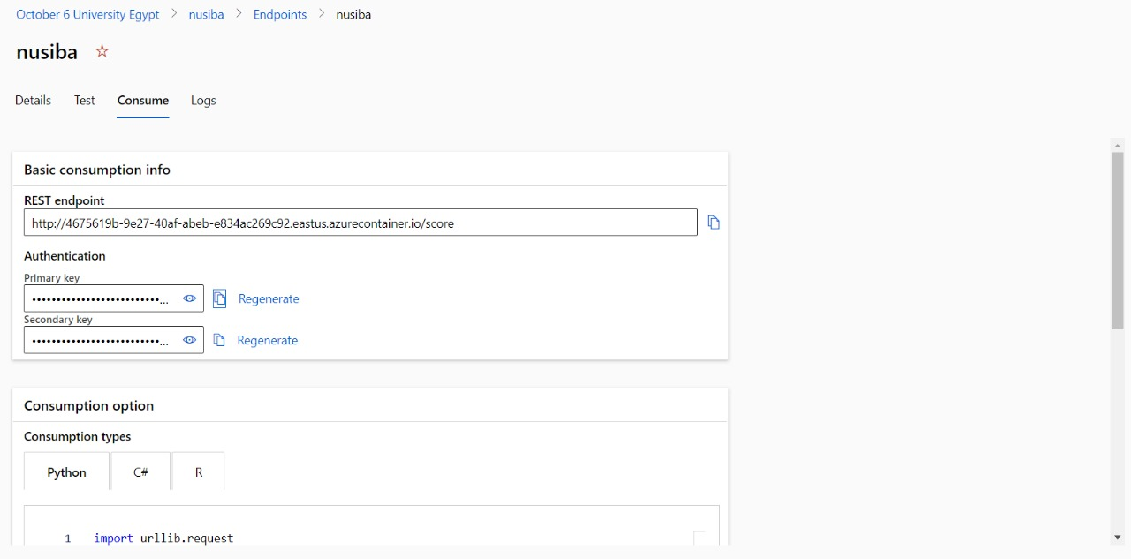

Slide 18
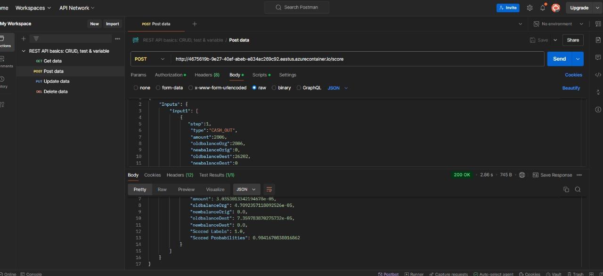

Slide 19
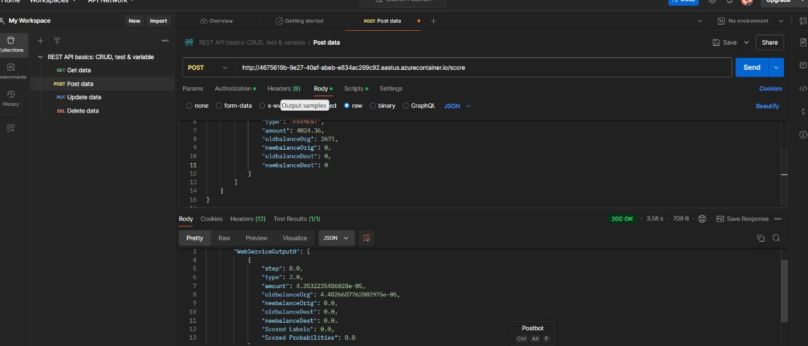

Slide 20
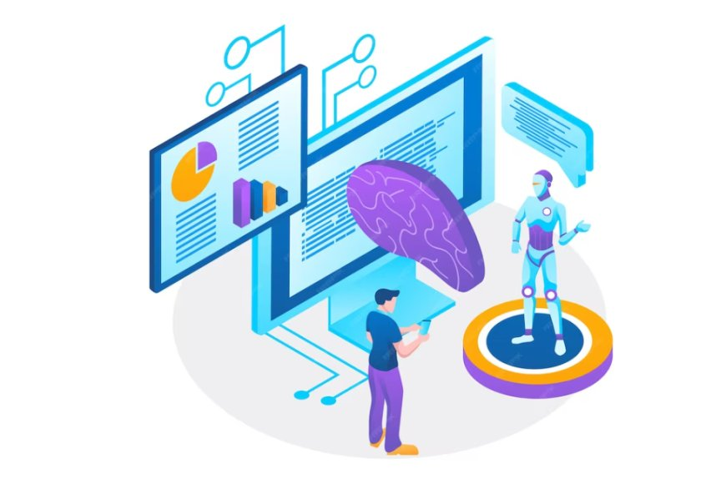
Week 4: MLOps, GANs, and Final Presentation
Tasks:
MLOps: Use ML flow to manage and track fraud detection models.
GANs for Synthetic Data: Implement a GAN to generate synthetic fraud transaction data for training and validation.
Final Report and Presentation: Document the project including data analysis, model development, and deployment.
Tools: MLflow, Python (TensorFlow/PyTorch for GANs), Azure services.

Slide 21
Challenges and Solutions
Challenges :- Imbalanced data
Solution:- Oversampling techniques

